Slide 1

Asymptotic Analysis
Design & Analysis of Algorithms
Saman Riaz (PhD)
Associate Professor
RSCI, Lahore
Lecture # 03

Slide 2
What’s Analysis of Algorithms
Design & Analysis of Algorithms
The theoretical study of algorithm’s performance and resource usage.
Other important features of an algorithm are
modularity
correctness
maintainability
functionality
robustness
user-friendliness
programmer time
Simplicity
extensibility
Reliability
During this course our focus will be on the performance and the storage requirements.

Slide 3
Types of Analysis
Worst case
Provides an upper bound on running time
An absolute guarantee that the algorithm would not run longer, no matter what the inputs are
Best case
Provides a lower bound on running time
Input is the one for which the algorithm runs the fastest
Average case
Provides a prediction about the running time
Assumes that the input is random

Slide 4
How do we compare algorithms?
We need to define a number of objective measures.
(1) Compare execution times?
Not good: times are specific to a particular computer !!
(2) Count the number of statements executed?
Not good: number of statements vary with the programming language as well as the style of the individual programmer.

Slide 5
Ideal Solution
Express running time t as a function of problem size n (i.e., t=f(n) ).
Given two algorithms having running times f(n) and g(n), find which functions grows faster.
Such an analysis is independent of machine time, programming style, etc.

Slide 6
How do we find f(n)?
Associate a "cost" with each statement.
Find the "total cost“ by finding the total number of times each statement is executed.
Algorithm 1 Algorithm 2
Cost Cost
arr[0] = 0; c₁ for(i=0; i<N; i++) c₂
arr[1] = 0; c₁ arr[i] = 0; c₁
arr[2] = 0; c₁
... ...
arr[N-1] = 0; c₁
----------- -------------

Slide 7
How do we find f(n)?
Associate a "cost" with each statement.
Find the "total cost“ by finding the total number of times each statement is executed.
Algorithm 1 Algorithm 2
Cost Cost
arr[0] = 0; c₁ for(i=0; i<N; i++) c₂
arr[1] = 0; c₁ arr[i] = 0; c₁
arr[2] = 0; c₁
... ...
arr[N-1] = 0; c₁
----------- -------------
c₁+c₁+...+c₁ = c₁ x N (N+1) x c₂ + N x c₁ = (c₂ + c₁) x N + c₂

Slide 8
How do we find f(n)?
Algorithm 3 Cost
sum = 0; c₁
for(i=0; i<N; i++) c₂
for(j=0; j<N; j++) c₂
sum += arr[i][j]; c₃
------------

Slide 9
How do we find f(n)?
Algorithm 3 Cost
sum = 0; c₁
for(i=0; i<N; i++) c₂
for(j=0; j<N; j++) c₂
sum += arr[i][j]; c₃
------------
c₁ + c₂ x (N+1) + c₂ x N x (N+1) + c₃ x N²

Slide 10
Comparing algorithms
Given two algorithms having running times f(n) and g(n), how do we decide which one is faster?
Compare “rates of growth” of f(n) and g(n)

Slide 11
Understanding Rate of Growth
Consider the example of buying elephants and goldfish:
Cost: (cost_of_elephants) + (cost_of_goldfish)
Approximation:
Cost ~ cost_of_elephants

Slide 12
Understanding Rate of Growth (cont’d)
The low order terms of a function are relatively insignificant for large n
n⁴ + 100n² + 10n + 50
Approximation:
n⁴
i.e., we say that n⁴ + 100n² + 10n + 50 and n⁴ have the same rate of growth
Highest order term determines rate of growth!

Slide 13
Work done by an algorithm
Let
T(n): running time
c_{op} : execution time for basic operation
C(n) : number of times basic operation is executed
Then we have: T(n) ≈ c_{op} C(n)

Slide 14
Types of formulas for basic operation count
Exact formula
e.g., C(n) = n(n-1)/2
Formula indicating order of growth with specific multiplicative constant
e.g., C(n) ≈ 0.5 n²
Formula indicating order of growth with unknown multiplicative constant
e.g., C(n) ≈ cn²

Slide 15
Example
Let C(n) = 3n(n-1) ≈ 3n²
Suppose we double the input size.
How much longer the program will run?

Slide 16
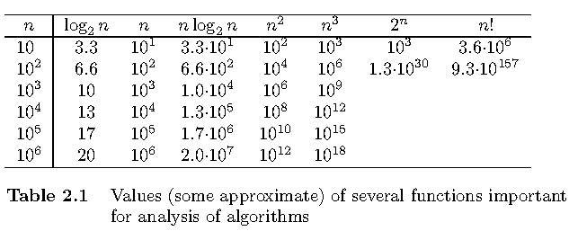
Orders of Growth

Slide 17
Example
Suppose you are designing a website to process user data (e.g., financial records).
Suppose program A takes f_{A}(n)=30n+8 microseconds to process any n records, while program B takes f_{B}(n)=n²+1 microseconds to process the n records.
Which program would you choose, knowing you’ll want to support millions of users?
Compare rates of growth:
30n+8 ~ n and n²+1 ~ n²

Slide 18
Visualizing Orders of Growth
On a graph, as you go to the right, a faster growing function eventually becomes larger...
f_{A}(n)=30n+8
Value of function →
f_{B}(n)=n²+1
Increasing n →

Slide 19
Rate of Growth ≡ Asymptotic Analysis
Using rate of growth as a measure to compare different functions implies comparing them asymptotically (i.e., as n → )
If f(x) is faster growing than g(x), then f(x) always eventually becomes larger than g(x) in the limit (i.e., for large enough values of x).

Slide 20
Asymptotic Notation
O notation: asymptotic “less than”:
f(n)=O(g(n)) implies: f(n) “≤” c g(n) in the limit*
c is a constant
(used in worst-case analysis)
*formal definition in CS477/677

Slide 21
Asymptotic Notation
Ω notation: asymptotic “greater than”:
f(n)= Ω (g(n)) implies: f(n) “≥” c g(n) in the limit*
c is a constant
(used in best-case analysis)
*formal definition in CS477/677

Slide 22
Asymptotic Notation
Θ notation: asymptotic “equality”:
f(n)= Θ (g(n)) implies: f(n) “=” c g(n) in the limit*
c is a constant
(provides a tight bound of running time)
(best and worst cases are same)
*formal definition in CS477/677

Slide 23
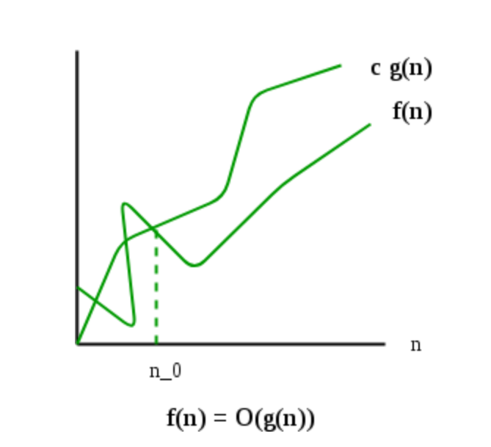
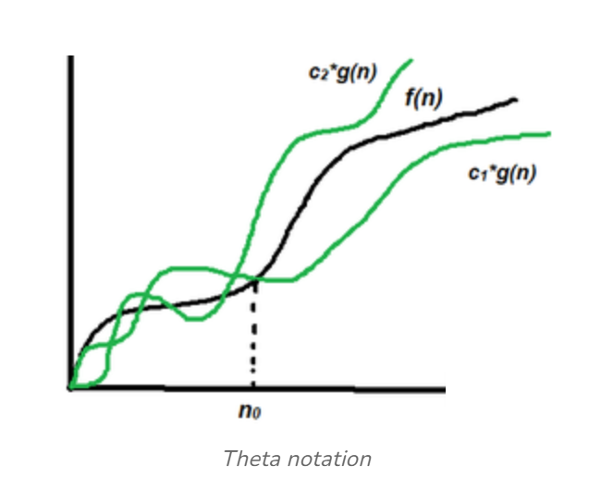
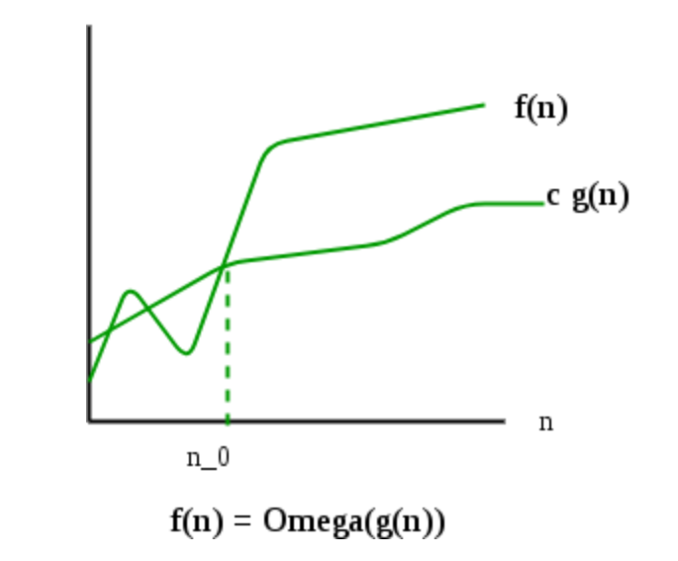

Asymptotic notations (Big O, Omega, Theta)
Worst Case
Upper Bound ( At most)
Best Case
Lower Bound(At least)
Average Case
Exact time
Notes:
F(n)< c.g(n): c>0, n>=n0, n0>=0
F(n)=2n^2+n
2n^2+n<c. n^2
2n^2+n<3 n^2
N<n^2
1<n

Slide 24
Why study algorithms ?
If you are given two brand new algorithms from two different companies to perform sorting. Which one you would go for ? Lets assume companies are not willing to install the software at your end for testing but are willing to share their pseudo-code with you.
You need an objective analysis of both the algorithms before you can choose one. Like:-
Scalability of algorithms
Real life constraints like time and storage
Behavior of the algorithms
Quickness (speed is fun)

Slide 25
Machine Independent Time
What is insertion sort’s worst-case time?
It depends on the speed of our computer:
relative speed (on the same machine),
absolute speed (on different machines).
BIG IDEA
Ignore machine-dependent constants.
Look at the growth of running time T(n) as n → ∞
“Asymptotic Analysis”

Slide 26
Θ-notation
Commonly used notation
Idea is to drop low-order terms, ignore leading constants
Example: 3n³+90n²-5n+6046 = Θ(n³)
Mathematically:
Θ(g(n)) = { f(n): there exist positive constants c₁,c₂, and n₀ such that 0 <= c₁ g(n) <= f(n) <= c₂ g(n) for all n >= n₀}

Slide 27
Asymptotic Performance
As n gets large enough, a Θ(n²) algorithm always beats a Θ(n³) algorithm.
We shouldn’t ignore asymptotically slower algorithms, however.
Real-world design situations often call for a careful balancing of engineering objectives.
Asymptotic analysis is a useful tool to help to structure our thinking.

Slide 28
Example Sorting (Insertion Sort)
Insertion-Sort(A,n) → A[1 … n]
for j ← 2 to n
do key ← A[j]
i ← j-1
while i > 0 and A[i] > key
do A[i+1] ← A[i]
i ← i -1
A[i+1] = key
1
i
j
n
key
sorted

Slide 29
Running time of Insertion Sort
The running time depends on the input: an already sorted sequence is easier to sort.
Parameterize the running time by the size of the input,
short sequences are easier to sort than long ones.
Generally, we seek upper bounds on the running time, because everybody likes a guarantee.

Slide 30
Analysis of Insertion Sort
Time to compute the running time as a function of the input size
1.for j=2 to length(A)
2. do key=A[j]
3.“insert A[j] into the sorted sequence A[1..j-1]”
i=j-1
while i>0 and A[i]>key
do A[i+1]=A[i]
i--
8. A[i+1]:=key
cost c₁
c₂
0
C₃
c₄
c₅
c₆
C₇
times n n-1 n-1 n-1
n-1

Slide 31
Insertion-Sort Running Time
T(n) = c₁ • [n] + c₂ • (n-1) + c₃ • (n-1) + c₄ •
(n-1) + c₅ • (Σ_{j=2,n} t_{j}) +
c₆ • ( Σ_{j=2,n} (t_{j} -1) ) + c₇ • ( Σ_{j=2,n} (t_{j} -1) )
+ c₈ • (n-1)
c₃ = 0, of course, since it’s the comment

Slide 32
Best/Worst/Average Case
Best case: elements already sorted ® t_{j}=1, running time = f(n), i.e., linear time.
Worst case: elements are sorted in inverse order ® t_{j}=j, running time = f(n²), i.e., quadratic time
Average case: t_{j}=j/2, running time = f(n²), i.e., quadratic time

Slide 33
Best Case Result
Occurs when array is already sorted.
For each j = 2, 3,…..n we find that A[i]<=key in line 5 when I has its initial value of j-1.
T(n) =
c₁ • n + (c₂ + c₄) • (n-1) + c₅ • (n-1)+ c₈ • (n-1)
= n • ( c₁ + c₂ + c₄ + c₅ + c₈ )
+ ( -c₂ – c₄ - c₅ – c₈ )
= c₉n + c₁₀
= f₁(n¹) + f₂(n⁰)

Slide 34
Worst Case T(n)
Occurs when the loop of lines 5-7 is executed as many times as possible, which is when A[] is in reverse sorted order.
key is A[j] from line 2
i starts at j-1 from line 4
i goes down to 0 due to line 7
So, t_{j} in lines 5-7 is [(j-1) – 0] + 1 = j
The ‘1’ at the end is due to the test that fails, causing exit from the loop.

Slide 35
Worst Case T(n), ctd.
T(n) = c₁ • [n]+ c₂ • (n-1) + c₄ • (n-1)
+ c₅ • (Σ_{j=2,n} j)+ c₆ • [ Σ_{j=2,n} (j -
1) ] + c₇ • [ Σ_{j=2,n} (j -1) ]+ c₈ •
(n-1)

Slide 36
Worst Case T(n), ctd.
T(n) =
c₁ • n + c₂ • (n-1) + c₄ • (n-1) + c₈ • (n-1)
+ c₅ • (Σ_{j=2,n} j)
+ c₆ • [ Σ_{j=2,n} (j -1) ]+ c₇ • [ Σ_{j=2,n} (j -1) ]
= c₉ • n + c₁₀ + c₅ • (Σ_{j=2,n} j) + c₁₁ •
[Σ_{j=2,n} (j -1) ]

Slide 37
Worst Case T(n), ctd.
T(n) = c₉ • n + c₁₀ + c₅ • (Σ_{j=2,n} j) + c₁₁ • [ Σ_{j=2,n} (j -1) ]
But
Σ_{j=2,n} j = [n(n+1)/2] – 1
so that
Σ_{j=2,n} (j-1) = Σ_{j=2,n} j – Σ_{j=2,n} (1)
= [n(n+1)/2] – 1 – (n-2+1)
= [n(n+1)/2] – 1 – n + 1 = n(n+1)/2 - n
= [n(n+1)-2n]/2 = [n(n+1-2)]/2 = n(n-1)/2
Wasn’t that fun?

Slide 38
Worst Case T(n), ctd.
In conclusion,
T(n) =
c₉ • n + c₁₀ + c₅ • [n(n+1)/2] – 1 + c₁₁ • n(n-1)/2
= c₁₂ • n² + c₁₃ • n + c₁₄
= f₁(n²) + f₂(n¹) + f₃(n⁰)

Slide 39
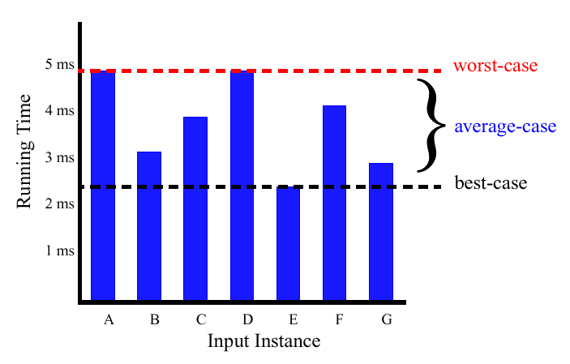
Best/Worst/Average Case (2)
For a specific size of input n, investigate running times for different input instances:
6n
5n
4n
3n
2n
1n

Slide 40
Insertion Sort Analysis
Is insertion sort a fast sorting algorithm?
Moderately so, for small n
Not at all, for large n

Slide 41
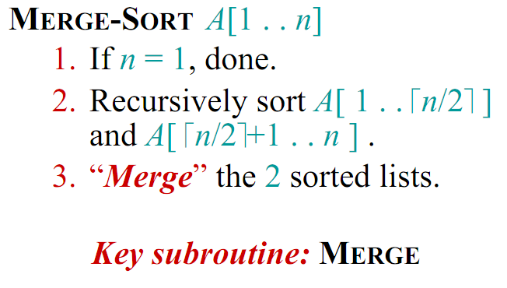
Merge Sort (Divide and Conquer)

Slide 42
Merge Sort Example
20
13
7
2
12
11
9
1
1
2
7
9
11
12
13
20

Slide 43
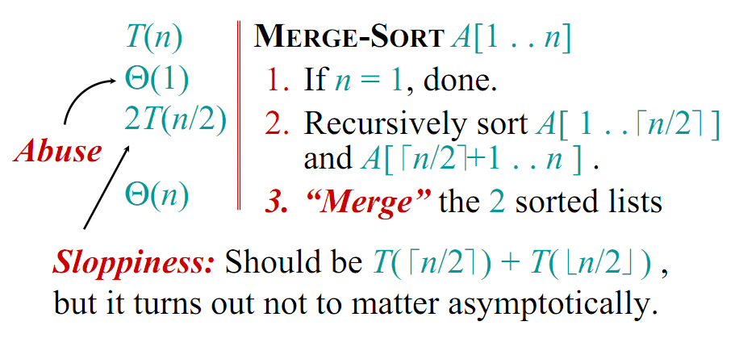
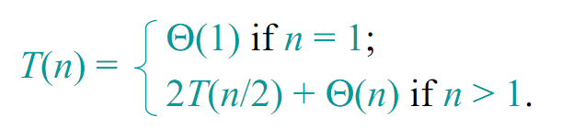
Analysis of Merge Sort

Slide 44
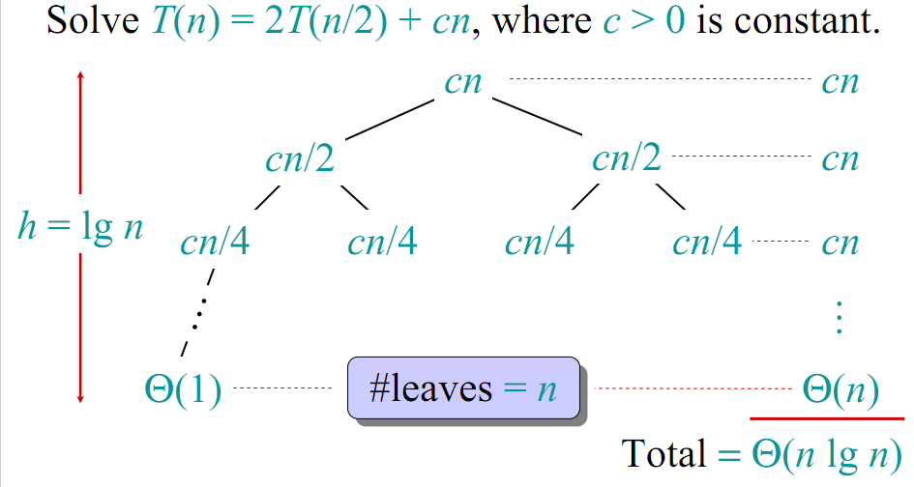
Visual Representation of the Recurrence for Merge Sort

Slide 45
Conclusion
Θ(nlgn) grows more slowly than Θ(n²)
Therefore, merge sort asymptotically beats insertion sort in the worst case.
In practice, merge sort beats insertion sort for n >=3

Slide 46
Quiz 1 Marks : 10 Time :10 mins
Question 1:
Design flowchart and calculate the running time of the given pseudo-code.
Start
Total=0
For i=1-50
Input x
If x>100
then total=total+1
end If
++i
Print total
End
n

